Slide 1
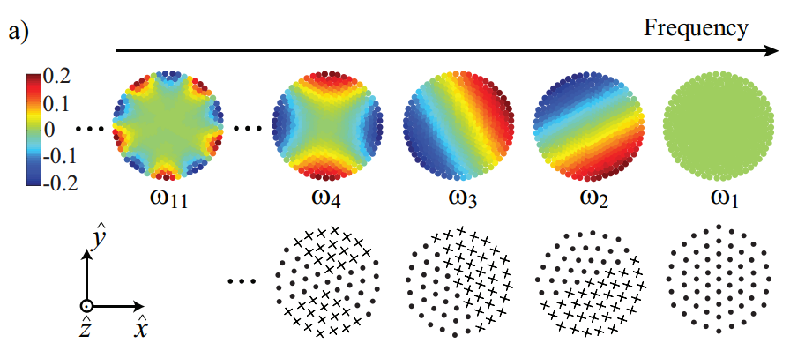
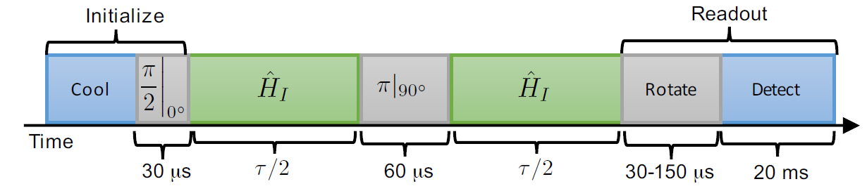
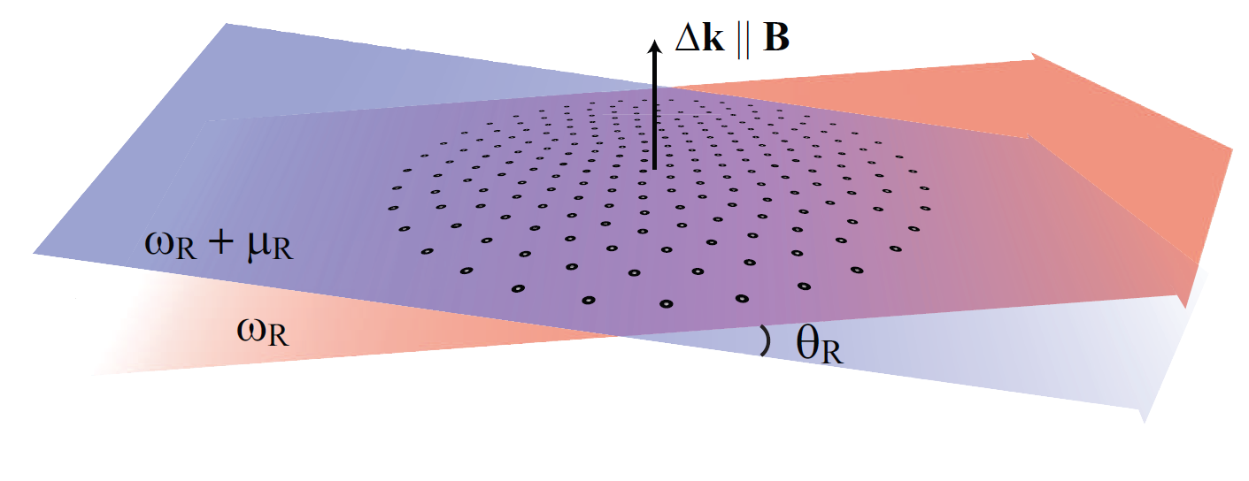
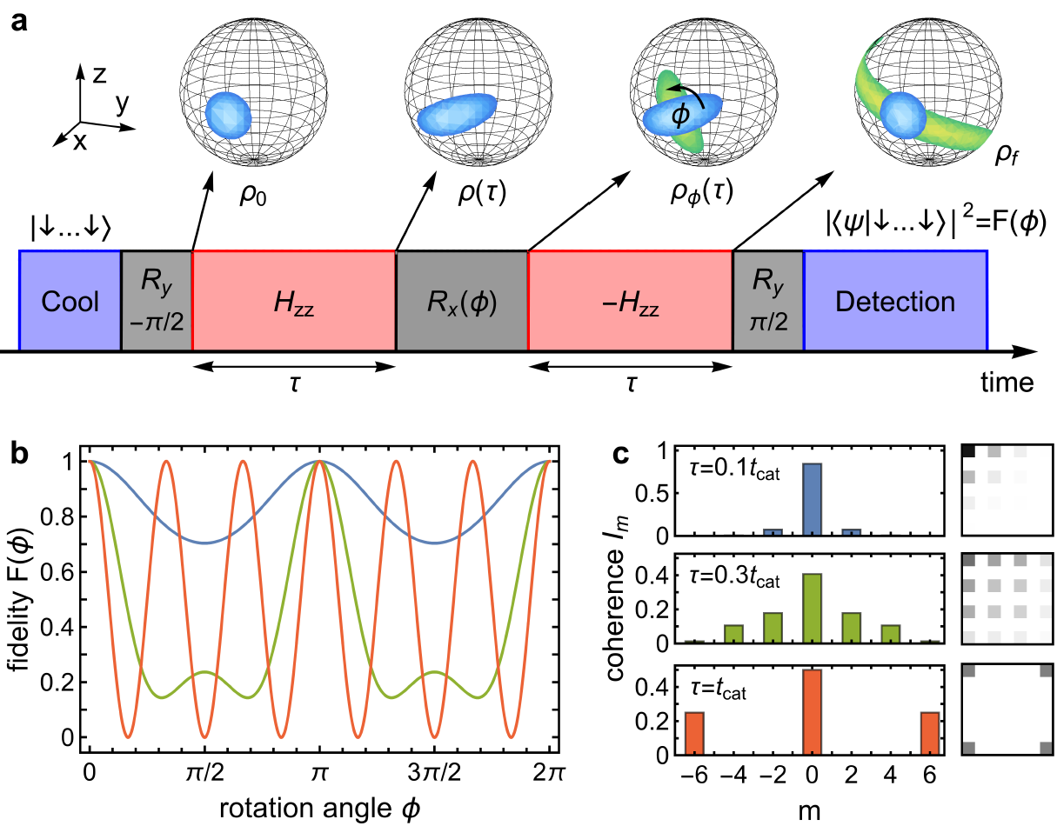
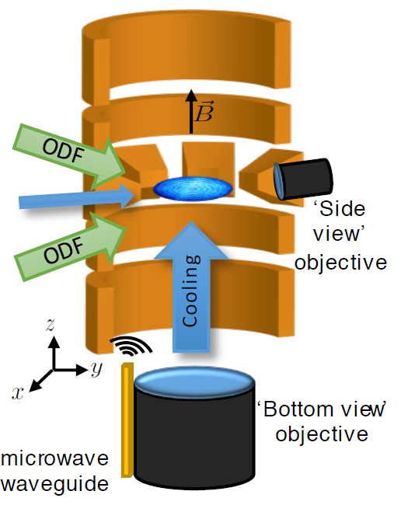
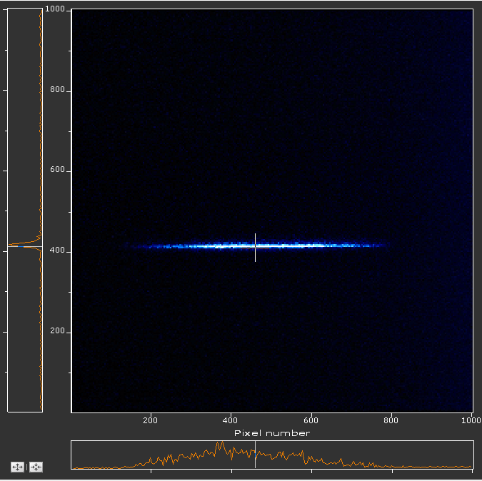
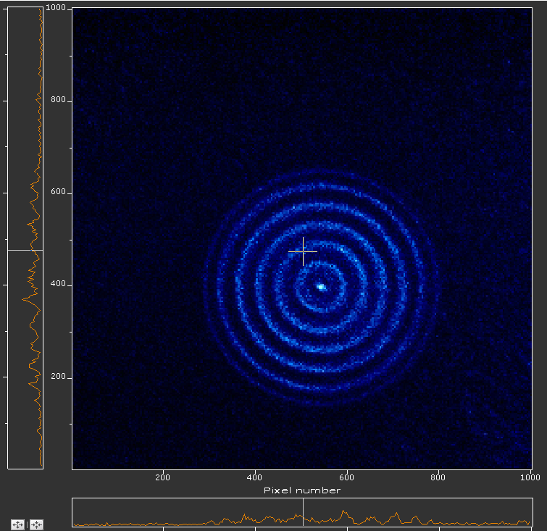
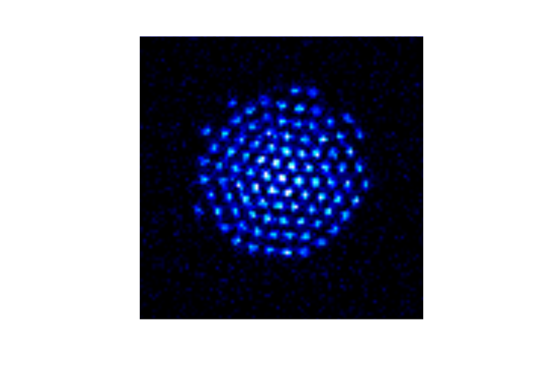
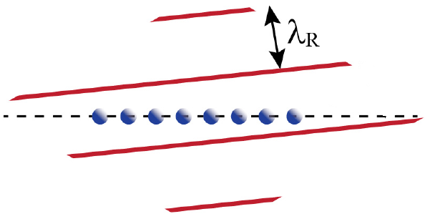
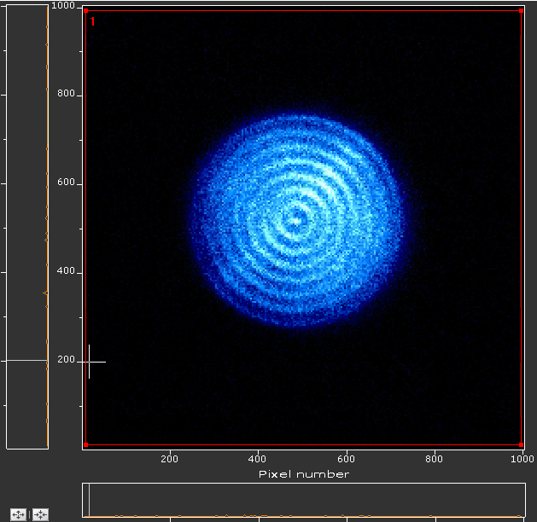
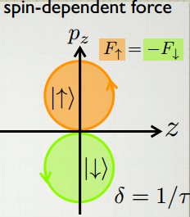
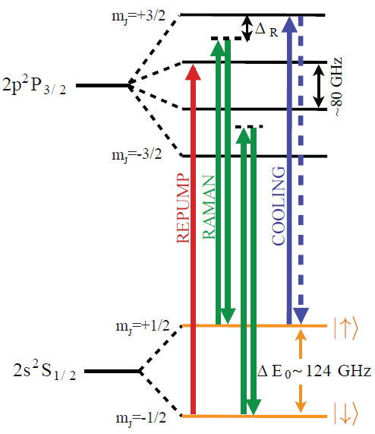
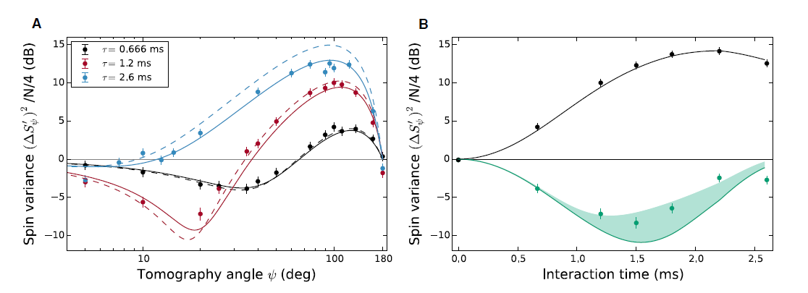
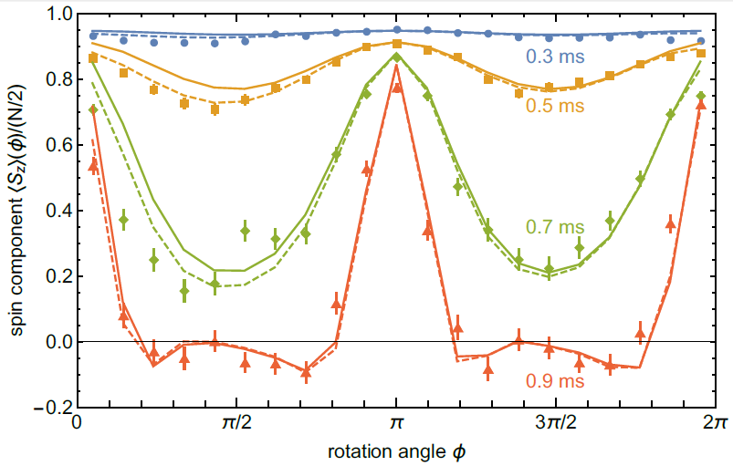
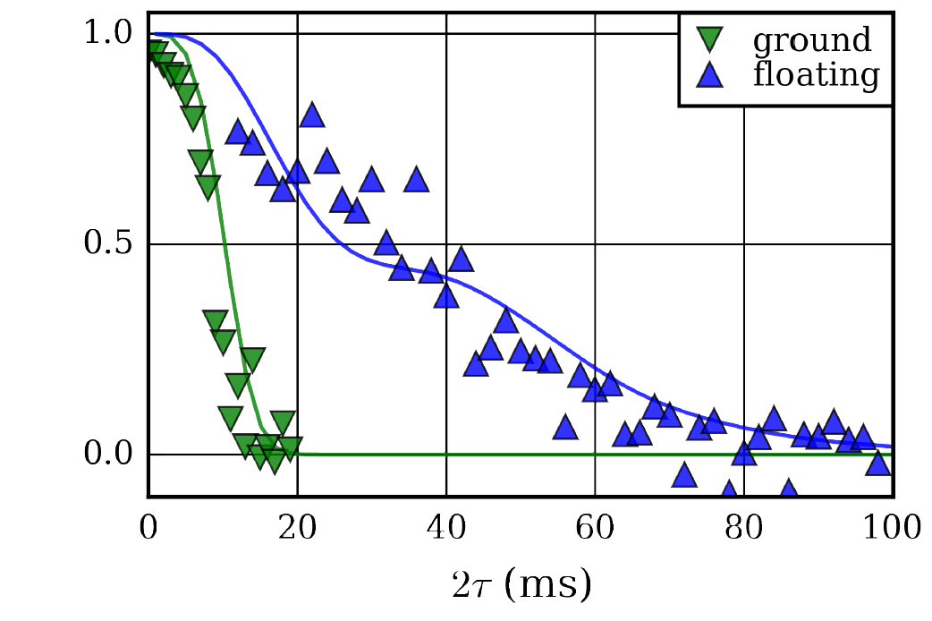
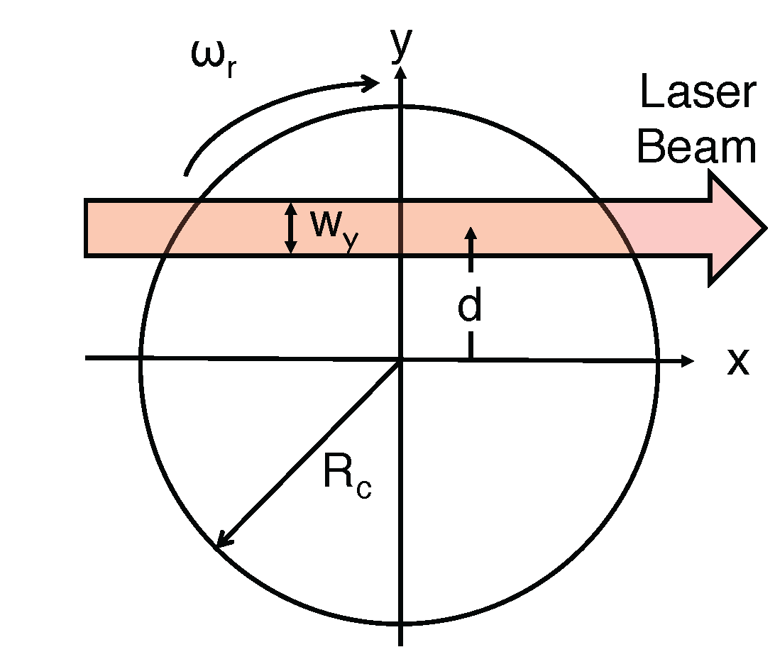
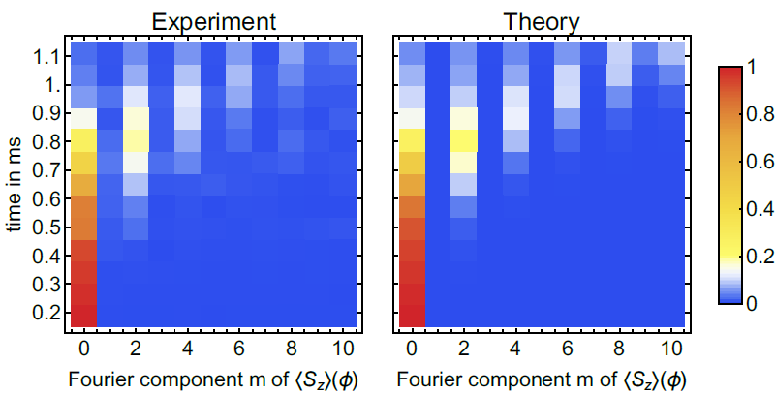
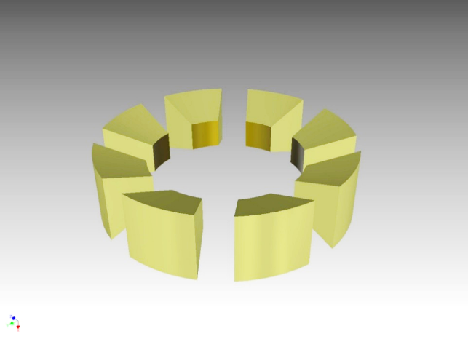
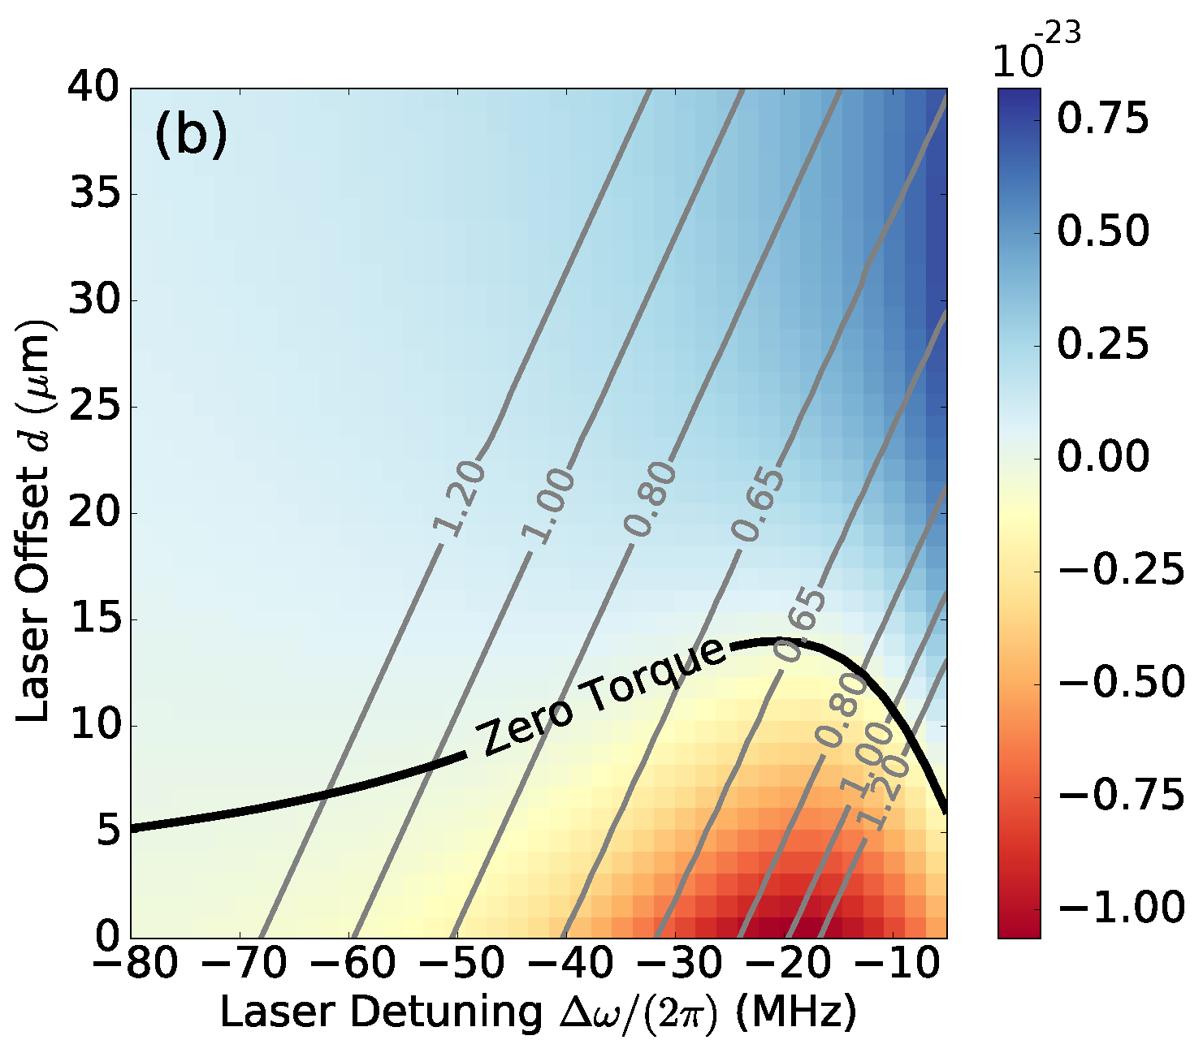
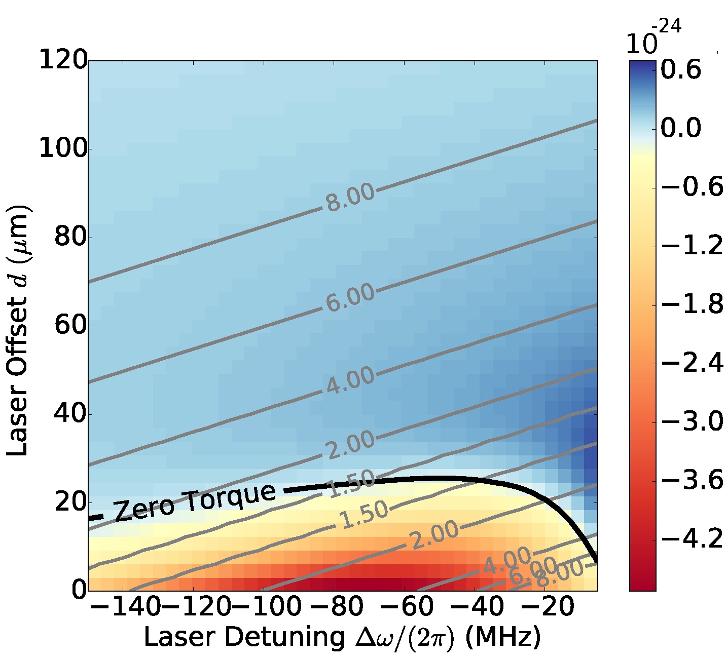
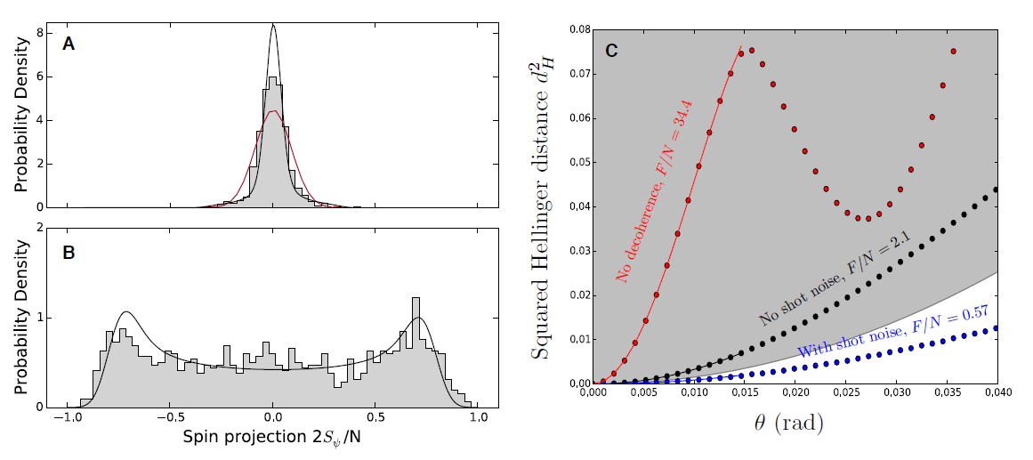
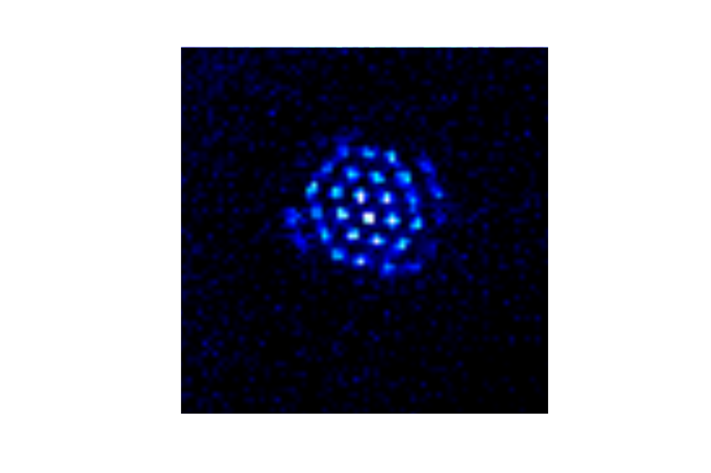
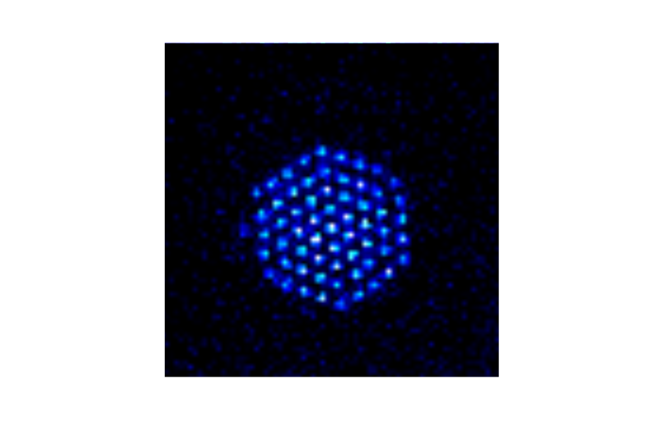
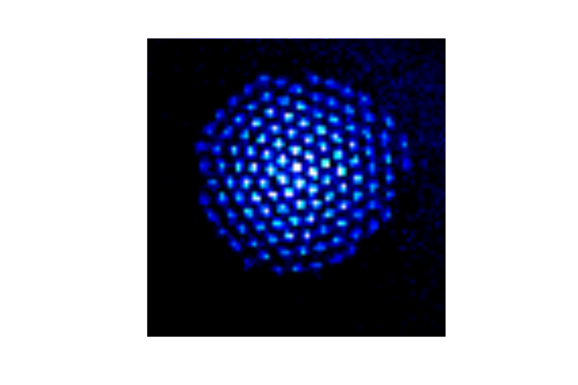




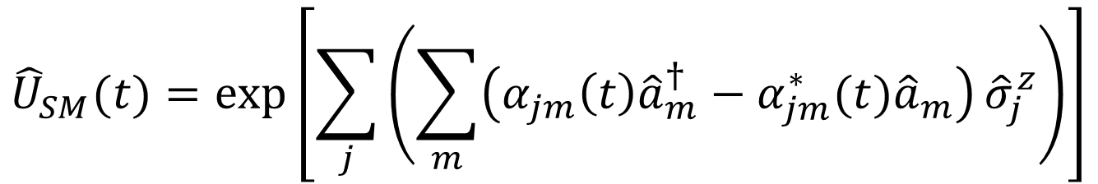
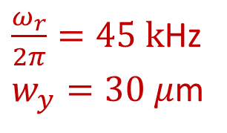
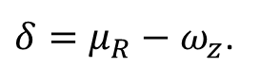
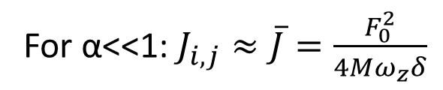
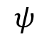
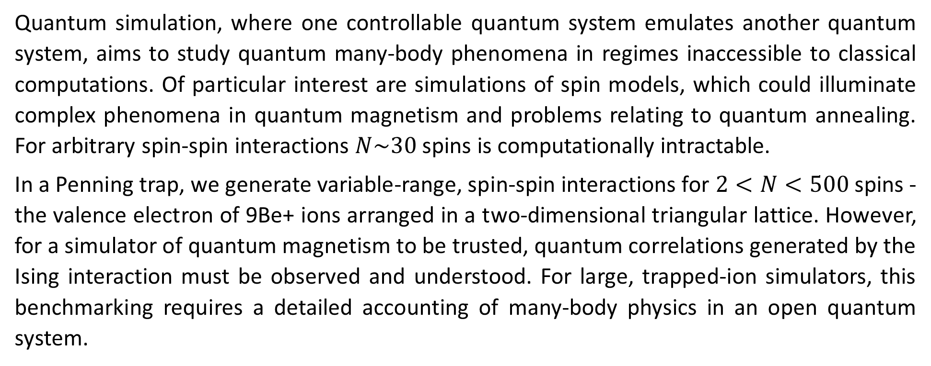
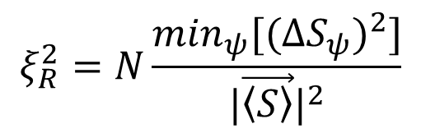
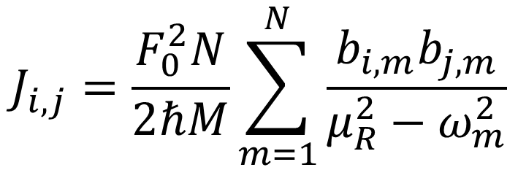
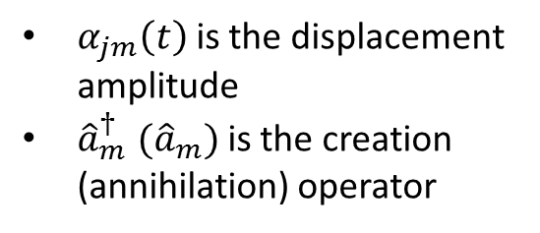
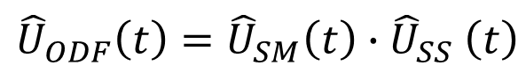
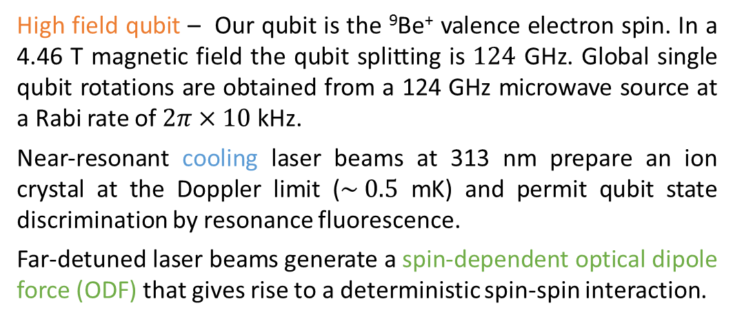
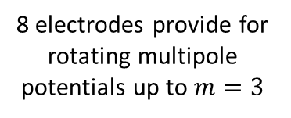
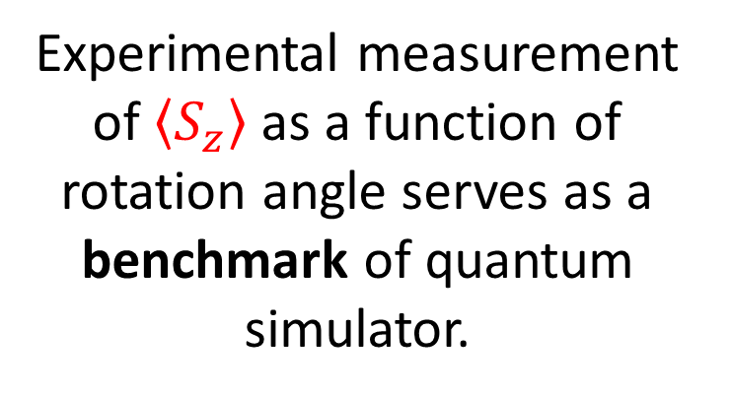
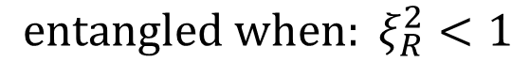
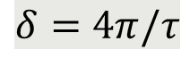

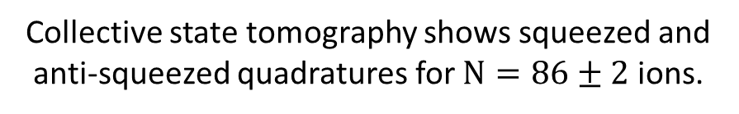
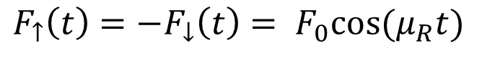
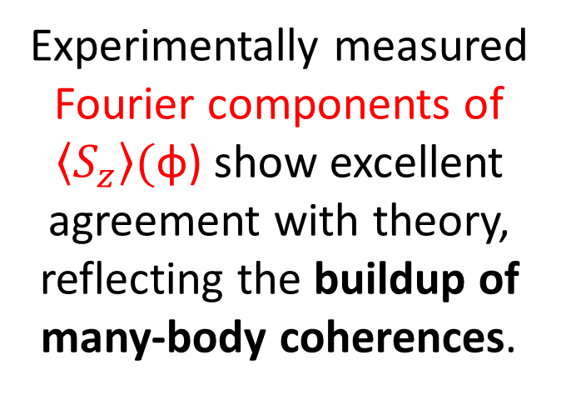
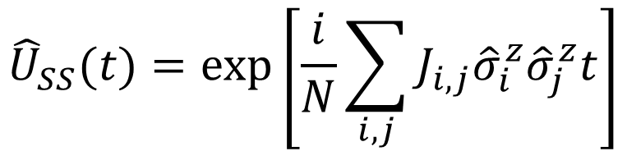
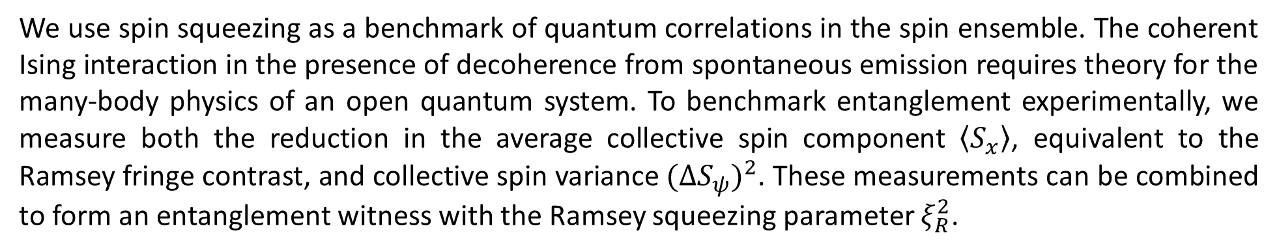
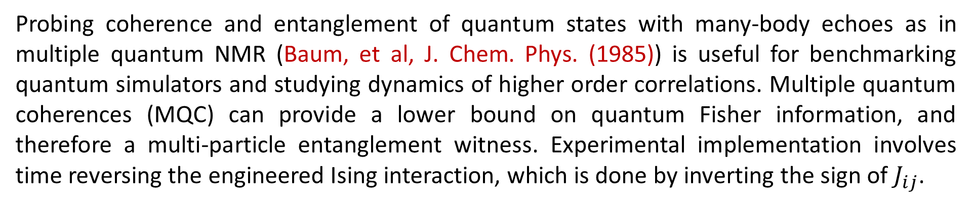
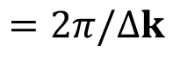
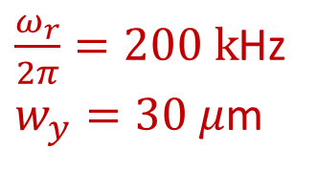
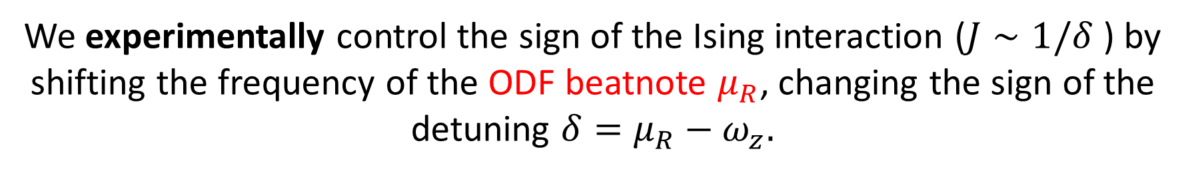
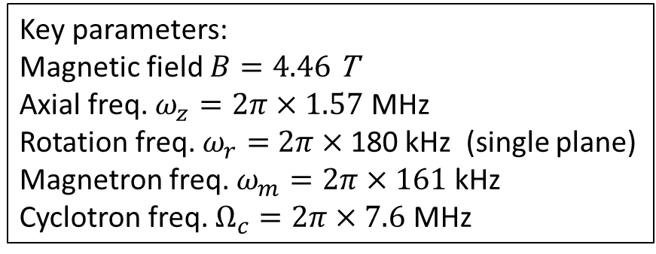
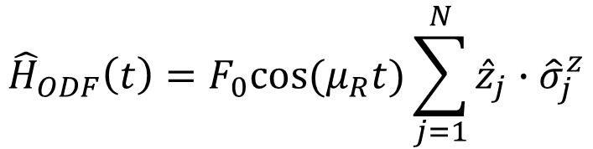

Motivation
Ising interaction with spin-dependent force
Spin squeezing and entanglement
Multiple quantum coherences
TALK: M. Gärttner N4.00004
Quantum simulation, where one controllable quantum system emulates another quantum system, aims to study quantum many-body phenomena in regimes inaccessible to classical computations. Of particular interest are simulations of spin models, which could illuminate complex phenomena in quantum magnetism and problems relating to quantum annealing. For arbitrary spin-spin interactions $N\sim 30$ spins is computationally intractable.
In a Penning trap, we generate variable-range, spin-spin interactions for $2<N<500$ spins - the valence electron of 9Be+ ions arranged in a two-dimensional triangular lattice. However, for a simulator of quantum magnetism to be trusted, quantum correlations generated by the Ising interaction must be observed and understood. For large, trapped-ion simulators, this benchmarking requires a detailed accounting of many-body physics in an open quantum system.
Two far-detuned laser beams produce a spin-dependent optical dipole force (ODF) at the ions that gives rise to a spin-spin interaction. Combined with a transverse magnetic field, we can realize non-trivial quantum magnetic interactions.
Bohnet, et al, arXiv:1512.03756 to be published in Science
Probing coherence and entanglement of quantum states with many-body echoes as in multiple quantum NMR (Baum, et al, J. Chem. Phys. (1985)) is useful for benchmarking quantum simulators and studying dynamics of higher order correlations. Multiple quantum coherences (MQC) can provide a lower bound on quantum Fisher information, and therefore a multi-particle entanglement witness. Experimental implementation involves time reversing the engineered Ising interaction, which is done by inverting the sign of $J_{ij}$.
We use spin squeezing as a benchmark of quantum correlations in the spin ensemble. The coherent Ising interaction in the presence of decoherence from spontaneous emission requires theory for the many-body physics of an open quantum system. To benchmark entanglement experimentally, we measure both the reduction in the average collective spin component $\left\langle S_{x}\right\rangle$, equivalent to the Ramsey fringe contrast, and collective spin variance $(ΔS_{ψ})^{2}$. These measurements can be combined to form an entanglement witness with the Ramsey squeezing parameter $ξ_{R}^{2}$.
Transverse B-field from
124 GHz microwaves
Coupling to different axial modes allows for a tunable interaction range
where $d_{ij}$ is the distance between ions $i, j$.
Engineered Ising interaction from
spin-dependent ODF
Overlap with initial state as a function of rotation angle yields oscillations from which the multiple quantum coherences are obtained.
Experimental Details
Lab frame CCD images
Experiment pulse sequence, composed of cooling laser pulses (blue), microwave pulses (grey), and ODF laser pulses (green).
$$J_{i,j}=\frac{F_{0}^{2}N}{2ℏM}\sum_{m=1}^{N}{\frac{b_{i,m}b_{j,m}}{μ_{R}^{2}−ω_{m}^{2}}}$$
Observe depolarization of the collective spin.
Distinguish destruction of correlations caused by decoherence from coherent depolarization caused by spin-spin interaction.
Side view
$$F_{↑}\left(t\right)=−F_{↓}\left(t\right)= F_{0}cos⁡(μ_{R}t)$$
Coherent Interactions
1D optical lattice wavefronts
$$=2π/Δk$$
spin-spin interaction
Coherent Ising interactions give rise to (over) squeezed state
Plot: Contrast decay for N = 21, 58, and 144 ions (black circles, red squares, and blue diamonds). Black squares show contrast decay from decoherence due to spontaneous emission in the absence of spin-spin coupling.
Cooling
For α<<1: $J_{i,j}≈\overline{J}=\frac{F_{0}^{2}}{4Mω_{z}δ}$
$$100 μm$$
$$100 μm$$
Spin-motion entanglement
TALK: A. Safavi-Naini N4.00005
Bottom view
Rotating frame from timed single photon counts
In the Penning trap, we realize the effective Ising Hamiltonian at specific decoupling points, where the spin-motion entanglement is eliminated.
Decoherence
Key parameters:
Magnetic field $B=4.46$ T
Axial freq. $ω_{z}=2π×1.57$ MHz
Rotation freq. $ω_{r}=$ $2π×$180 kHz (single plane)
Magnetron freq. $ω_{m}=2π×161$ kHz
Cyclotron freq. $Ω_{c}=2π×7.6$ MHz
$${\hat{H}}_{ODF}\left(t\right)=F_{0}cos⁡(μ_{R}t)\sum_{j=1}^{N}{{\hat{z}}_{j}{∙\hat{σ}}_{j}^{z}}$$
Decoherence leads to shortening of Bloch vector
$${\hat{U}}_{ODF}\left(t\right)={\hat{U}}_{SM}\left(t\right){∙\hat{U}}_{SS}\left(t\right)$$
$${\hat{U}}_{SM}(t)=\exp\left[\sum_{j}{\left(\sum_{m}{\left(α_{jm}\left(t\right){\hat{a}}_{m}^{†}−α_{jm}^{∗}(t){\hat{a}}_{m}\right)}{\hat{σ}}_{j}^{z}\right)}\right]$$
Idealized fidelity signal for different evolution times τ.
Fourier transforms of the fidelity signals. The Fourier amplitudes are identical with the multiple quantum coherences.
⁹Be⁺ qubit system
High field qubit – Our qubit is the ⁹Be⁺ valence electron spin. In a 4.46 T magnetic field the qubit splitting is $124$ GHz. Global single qubit rotations are obtained from a 124 GHz microwave source at a Rabi rate of $2π×10$ kHz.
Near-resonant cooling laser beams at 313 nm prepare an ion crystal at the Doppler limit ($\sim 0.5$ mK) and permit qubit state discrimination by resonance fluorescence.
Far-detuned laser beams generate a spin-dependent optical dipole force (ODF) that gives rise to a deterministic spin-spin interaction.
Measure and benchmark modification of collective spin variance
and verify entanglement using spin-squeezing.
We experimentally control the sign of the Ising interaction ($J∼1/δ$) by shifting the frequency of the ODF beatnote $μ_{R}$, changing the sign of the detuning $δ=μ_{R}−ω_{z}.$
Spin-motion entanglement
Decoherence in Bloch vector
Metrological tool
Large term for small detunings
$α_{jm}\left(t\right)$is the displacement amplitude
${{\hat{a}}_{m}^{†} (\hat{a}}_{m})$is the creation (annihilation) operator
$$δ=4π/τ$$
Residual spin-motional entanglement leads to shortening of the Bloch vector and is minimized at certain drive times for a given detuning,
T2 Coherence time
$${\hat{U}}_{SS}(t)=\exp\left[\frac{i}{N}\sum_{i,j}{J_{i,j}{\hat{σ}}_{i}^{z}{\hat{σ}}_{j}^{z}t}\right]$$
Spin-spin coupling
Ising interaction
Dominant for large detunings
Experimental measurement of $\left\langle S_{z}\right\rangle$ as a function of rotation angle serves as a benchmark of quantum simulator.
$$ψ$$
Fringe Contrast
$δ=μ_{R}−ω_{z}$.
Collective state tomography shows squeezed and anti-squeezed quadratures for $N=86±2$ ions.
Quantum spin correlation dynamics point to the formations of oversqueezed states.
Perpendicular laser cooling with a rotating wall
Torrisi, Britton, Bohnet, Bollinger, PRA 93 (2016)
Depolarization combined with spin variance allows us to evaluate the entanglement witness.
For future implementation of single spin state readout, low in-plane temperatures with minimal torques on the crystal are needed for improved crystal stabilization.
2-D geometry for
perpendicular laser cooling
Entanglement witness:
$$ξ_{R}^{2}=N\frac{\min_{ψ}[(ΔS_{ψ})^{2}]}{|\vec{\left\langle S\right\rangle }|^{2}}$$
Evolution time (ms)
$${entangled when: ξ}_{R}^{2}<1$$
Experimentally measured Fourier components of $\left\langle S_{z}\right\rangle ($φ) show excellent agreement with theory, reflecting the buildup of many-body coherences.
Britton et al., arXiv_1512.00801, to be published in PRA
Maximum observed squeezing of -6.0 dB with 88 ions. Entanglement observed for N from 20 to 220 ions.
Controlling 2D crystals with rotating potentials
Account for energy exchange with a rotating wall:
Low in-plane temperatures more readily achievable with a rotating wall than without.
We apply a controlled torque to the ion crystal using a weak ‘rotating wall’ potential. This radially asymmetric potential is produced using split ring electrodes at the axial trap center. Controlling the rotation frequency stabilizes the radial trapping potential, producing stable ions crystals in a well-defined rotating frame.
Rotating wall provides an energy sink for the work done
by the perpendicular beam in applying a torque.
Observe non-Gaussian counting statistics in collective spin state.
Disappearance of spin-squeezing at long times consistent with formation of over-squeezed state - not just degradation due to decoherence.
Contours of equilibrium temperature (mK) with a color plot of the perpendicular laser torque (Joules)
MQC spectrum shows the time dynamics of many-body correlations. The coherences are a witness for n-body entanglement, though entanglement is not observed here.
8 electrodes provide for rotating multipole potentials up to $m=3$
$\frac{ω_{r}}{2π}=45 k$Hz
$w_{y}=30 μ$m
$\frac{ω_{r}}{2π}=200 k$Hz
$w_{y}=30 μ$m
Future Directions
Transverse magnetic field, with variable range spin-spin interactions
Sensitive force detection
Apply sub-Doppler cooling (EIT) to the axial drumhead modes
Implement single-ion resolved readout
50 μm
N=25
N=61
N=91
N=124
Theory by M. Wall
50 μm
Images of different single-plane crystals in the rotating frame.
Composed of data from 1-2 seconds of integration.
Full counting statistics of a non-Gaussian spin state. Histograms showing the (A) squeezed and (B) anti-squeezed quadratures of the collective spin.
Fisher information (F) is extracted from theoretically computer Hellinger distance. F/N > 1 indicates the state is entangled.

